Slide 1
Market Share as Innovators, Competitors, And Challenger

Slide 2
Market share reflects a company's portion of total industry sales and can be a key indicator of its competitiveness and profitability. Companies can be categorized as market leaders, challengers, followers, or niche marketers, each with distinct strategies for securing or expanding their market position.

Slide 3
Market Leaders: hold the largest market share and often lead in innovation, technology, and customer service.
Market Challengers: aim to increase their share by aggressively competing with leaders, often through price wars or innovative strategies.
Market Followers: primarily focus on replicating the success of market leaders, sometimes with slight modifications or variations.
Market Niche Marketers: focus on specific segments or niches within the broader market, often offering specialized products or services

Slide 4
Market leader typically has the largest market share and, by virtue of its pricing, advertising intensity, distribution coverage, technological advance and rate of new product introductions, it determines the nature, pace and bases of competition. It is this dominance that typically provides the benchmark for other companies in the industry

Slide 5
However, market leadership, though often associated with size, in reality is a more complex concept and should be seen in terms of an organization’s ability to determine the nature and the bases of competition within the market.
‘Thought leadership‘ that is based not so much upon size, but upon innovation and different patterns of thinking.

Slide 6
STRATEGIES FOR MARKET LEADERS 1. How best to expand the total market
2. How to protect the organization’s current market share
3. How to increase market share

Slide 7
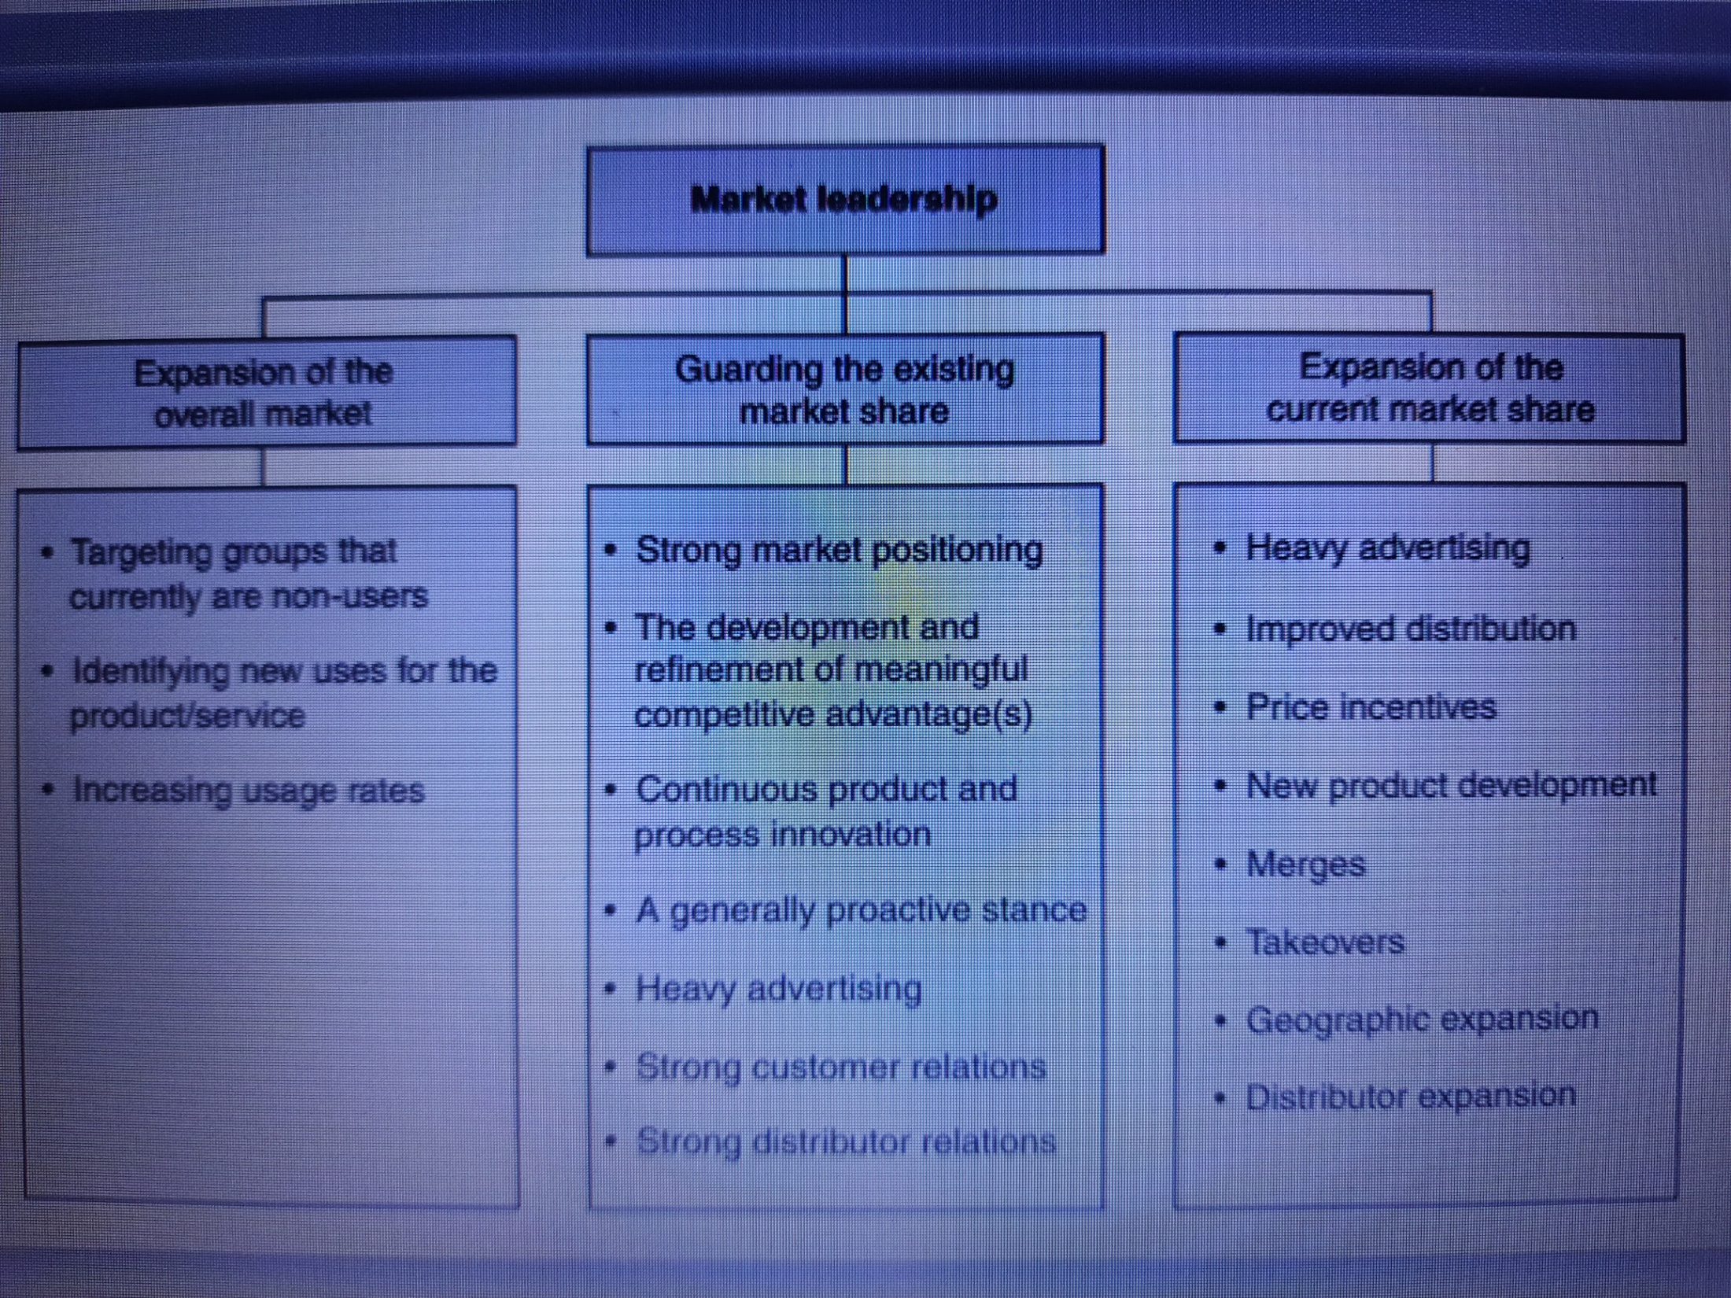

Slide 8
Market challengers and followers: Firms with a slightly smaller market share can adopt one of two stances. They may choose to adopt an aggressive stance and attack other firms, including the market leader, in an attempt to gain share and perhaps dominance (market challengers), or they may adopt a less aggressive stance in order to maintain the status quo (market followers)

Slide 9
Market nichers: Virtually every industry has a series of small firms that survive, and indeed often prosper, by choosing to specialize in parts of the market that are too limited in size and potential to be of real interest to larger firms. By concentrating their efforts in this way, market nichers are able to build up specialist market knowledge and avoid expensive head-on fights with larger companies.
Identify marketers in
edible oil industry
Car Markets

Slide 10
LEADERS: Expand the market
Protect the current share
Expand share
Challengers: Discount or cut prices
Sale Cheap goods
Innovate products and distribution
Improve services
Advertise heavily
Proliferate the range
Reduce costs
Followers : Segment carefully
Use R&D cleverly and Discount or cut prices
Challenge conventional wisdoms
Nichers: Get Smarter to identify spaces

